Slide 1
Flexible Sleeper Berth Pilot Program
October 27, 2014
Martin R. Walker,
Chief Research Division

Slide 2
Effects of Split Sleep on CMV Driver Safety and Health
An in-residence laboratory was conducted on 53 healthy participants from January 10, 2010 to May 5, 2011.
Study evaluated split sleep versus consolidated sleep based on total sleep time, performance, subjective drowsiness, and biomedical measures that correlated with health.
Three group design: 1. Consolidated nighttime sleep, 2. Split sleep, and 3. Consolidated daytime sleep.
Findings: The daytime consolidated sleep group slept less, had increased sleepiness, and an increase in blood glucose and testosterone at the end of the work week.
Conclusion: Results suggested that when consolidated nighttime sleep was not possible, split sleep is preferable to consolidated daytime sleep.
http://ntl.bts.gov/lib/51000/51200/51254/12-003-Split-Sleep_Investigation-of-the-Effects-of-Split-Sleep-Schedules-on-Commercial-Vehicle-Driver-Safety-and-Health-508.pdf

Slide 3
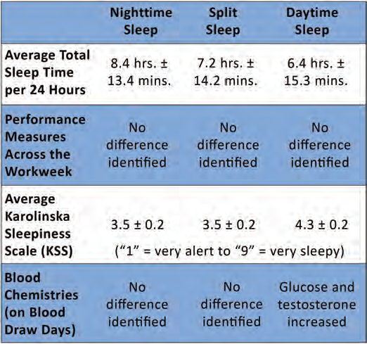
Effects of Split Sleep on CMV Driver Safety and Health

Slide 4
Flexible Sleeper Berth Provision
Establish a pilot program as specified in 49 CFR Section 381.400.
A pilot program allows collection of specific data for evaluating alternatives to the regulations or innovative approaches to safety while ensuring safety goals of the regulations are satisfied.
Study in which temporary regulatory relief from the sleeper berth provision to allow some driver flexibility to split sleep when tired.
The number of participants must be large enough to ensure statistically valid findings.
Pilot program must include an oversight plan to ensure that participants comply with the terms and conditions of participation (Study Protocol) , and procedures to protect the health and safety of study participants and the general public.
Notes:
Proposed Sleeper Berth Provision. Drivers using the sleeper berth provision must take at least 8 hours in the sleeper berth, this time can be split into any combination of 2 periods, plus a separate 2 consecutive hours either in the sleeper berth, off duty, or any combination of the two. Sleeper Berth time will not be calculated in the 14 hour period.

Slide 5
Pilot Program Design
Purpose: Evaluate the impact on driver fatigue of allowing drivers to split their sleep into multiple periods during the day and night.
Design: Within Subject and Between Subject Research Design
Method: Automated data collection to reduce researcher/driver interface
Period of Data Collection: 90 days
Study Sample: Stratified sample based on carrier size and other important groups
Size of Carrier | Sample Size
Small (2-50 trucks) | 50
Medium (51-500 trucks) | 50
Large (501+ trucks) | 50
Owner Operators | 25
Team Drivers | 25
Goal is to Collect Data on 200 Drivers
Notes:
FMCSA want to stratify the sample based on carrier size (small, medium, and large) or up to 600 drivers. Additionally, FMCSA wants to include a sample of up to 200 owner operators and 200 team drivers. The Agency is often criticized for not including small carries and owner operators in their research studies. The Agency will solicit volunteers via Owner-Operator Independent Drivers Association (OOIDA) and the National Association of Small Trucking Companies (NASTC).

Slide 6
Study Process
Automated data collection to reduce researcher/driver interface
Steps | Driver | Study Agent
Application | Apply to program via website | Screen driver candidates
Fatigue Training | Receive fatigue mgmt training & provide certificate | Verify completion of NAFMP driver training certificate
Study Protocol Instruction | Review video instruction on study protocol data collection elements | Verify driver completion and mail data collection equipment
Equipment Setup | Receive via mail study data collection equipment | Provide final conference call with drivers
Testing | Attend final conference call with study agent | Test data collect equipment
Data Collection/ Monitoring | Completion of PVT and KSS assessment | Monitor Data Compliance (daily monitoring data being collected, notifications of non compliance)

Slide 7
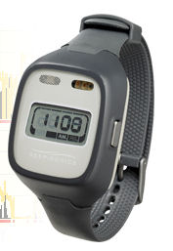
Data Collected
Driving Behavior: Use fleet management system or an Onboard Monitoring System (OBMS) to monitor driving behavior that might be indicative of fatigue – Safety critical events, shifting patterns, speed variability, curve events, and lane departures and vehicle movement.
Psychomotor Vigilance Task (PVT): PVT measures reaction times to stimuli. Drivers will perform PVT when completing their duty day and at the start of their next duty day.
Actigraph Watch: Collect actigraphy data wirelessly on sleep/wake patterns, heart rate, respiration rate and physical activity.
Electronic Driver Logbooks: Drivers’ logs could be collected with the primary purpose of tracking how they are splitting their off-duty time.
Karolinska Sleepiness Scale (KSS): The KSS is a 9-point subjective sleepiness scale that has been shown to provide a good estimate of sleepiness.
Roadside Violations: Collect data of driver roadside violations
Crashes and Incidents: Data on crashes and other incidents would be collected and include time of day, severity, and type of crash.
Driver Survey: Identify driver opinions regarding sleep flexibility
Notes:
Notes
1.

Slide 8
Final Products
Previous laboratory research suggests that by allowing greater flexibility in sleep time and placement (increasing night-time sleep) for CMV drivers may result in improved safety outcomes by improving or sustaining driver alertness.
Study report that tests the premise that allowing greater flexibility in sleep time and placement will reduce driver fatigue.
Public use data set on work hours and driver fatigue.

