Slide 1
GATS Sponsorship/Directory Opportunities

Slide 2
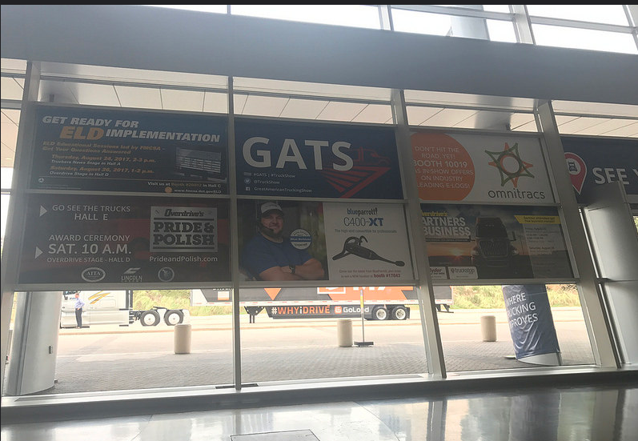
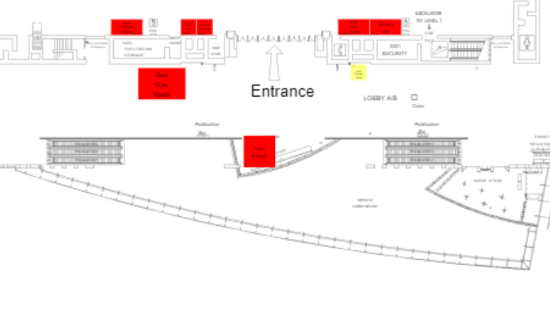
GATS Window Graphic
Be the first message attendees see as they enter from the shuttle buses coming from truck parking and the hotels
$5,000 Your rate $4,000
Double sided graphic
Shuttle bus path
Escalator to registration
Window graphic location

Slide 3
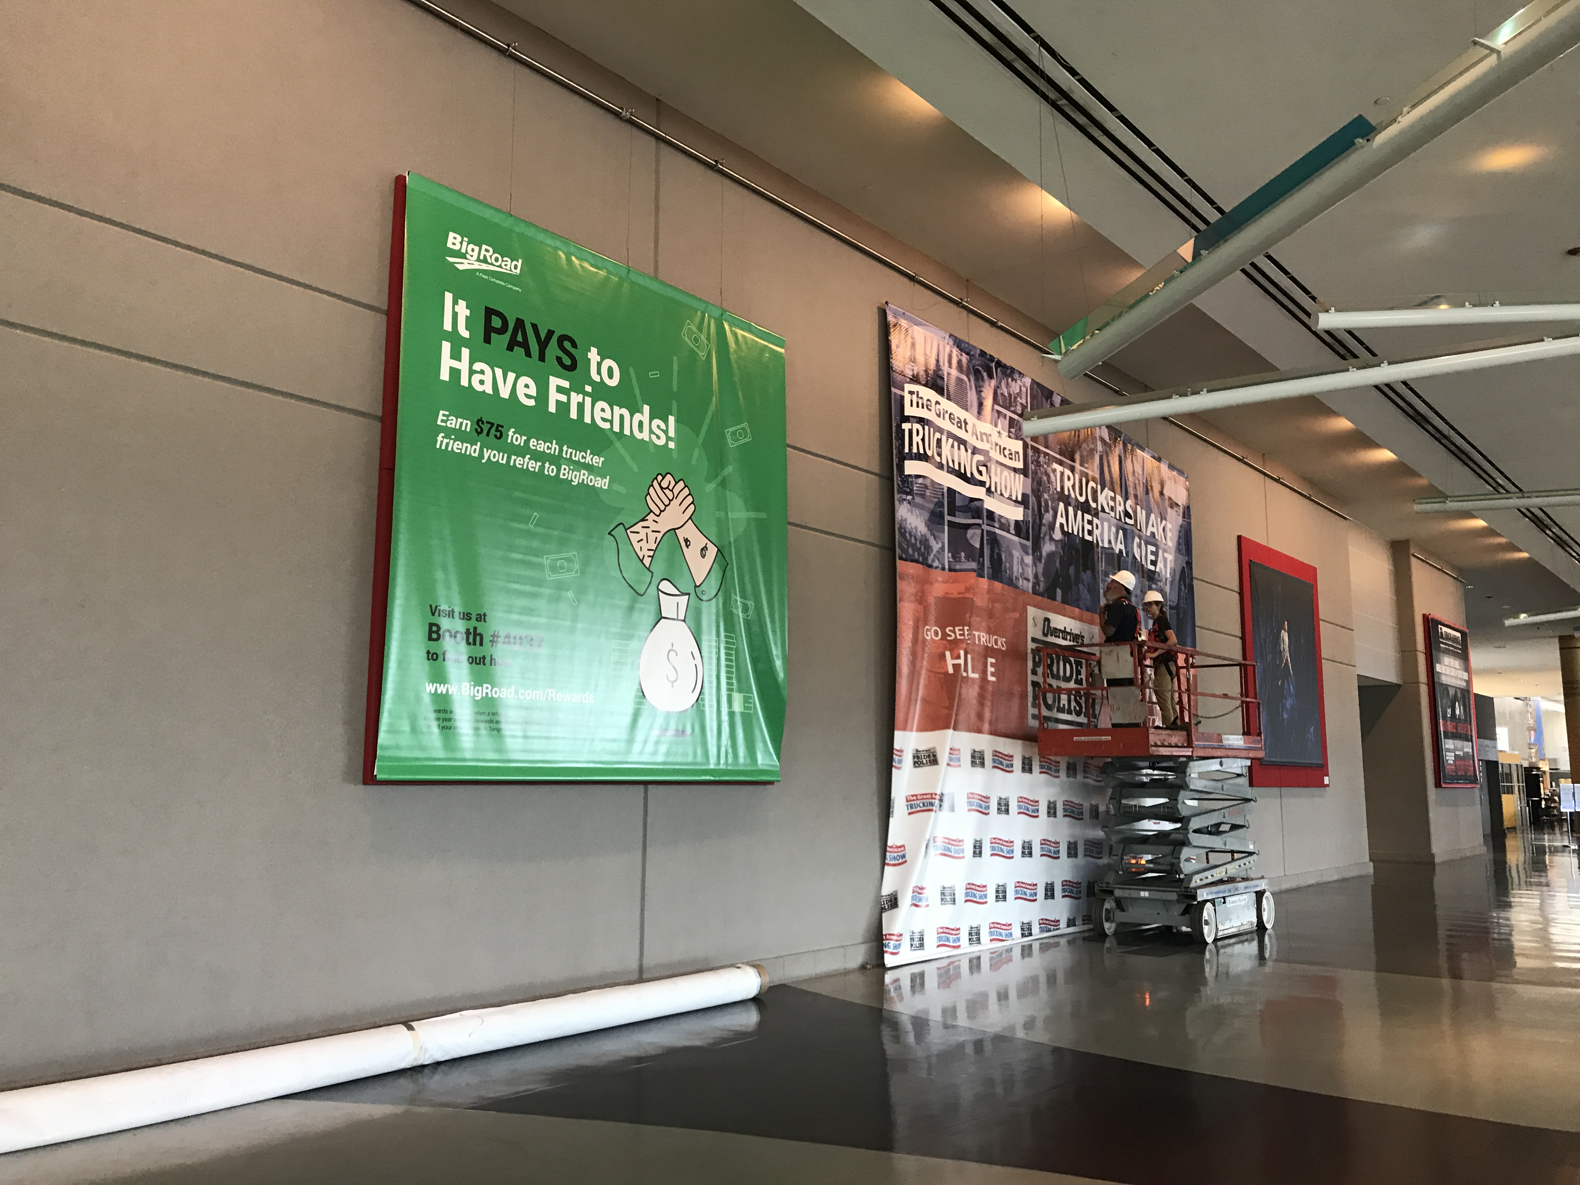
GATS Wall Banner
Make certain your message is seen as attendees enter the show floor
$6,500 Your rate $5,000
10’ x 10’ banners
Includes production and installation

Slide 4
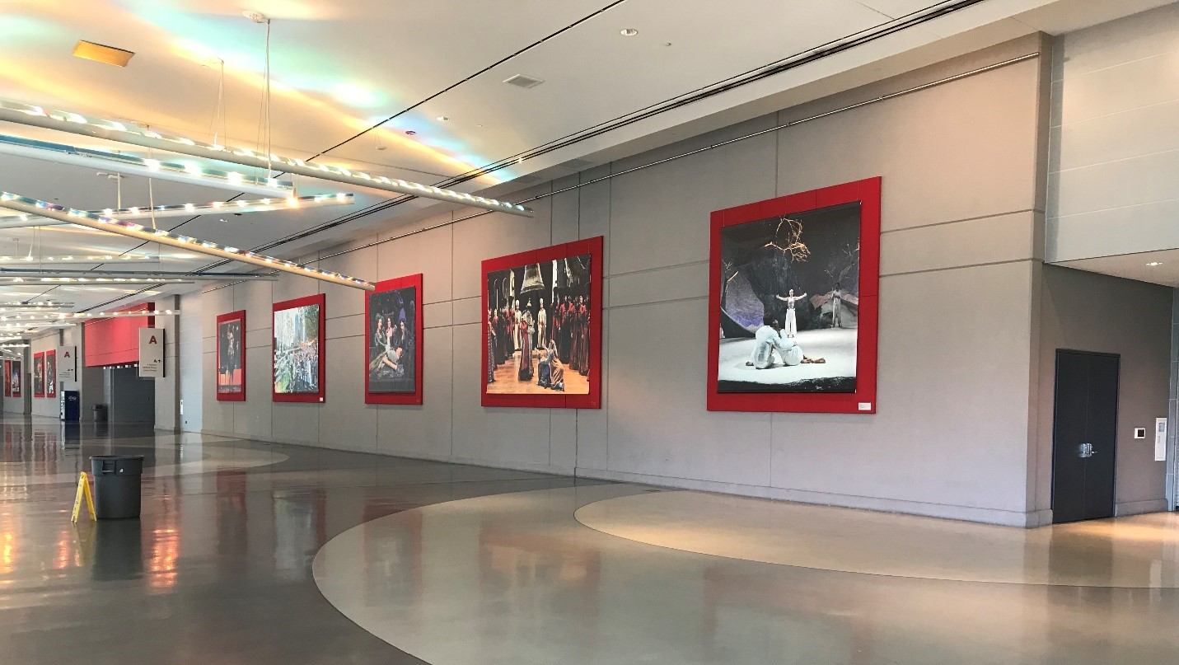
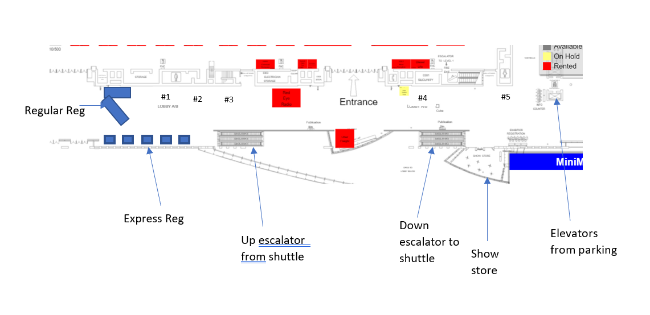
GATS Wall Banner
Banner placement

Slide 5
GATS Truck Parking Permit
Each truck parking in GATS parking area will have this hanger in their truck. Your logo and booth number will be seen every time they enter their cab
$1,500
Your Rate $1,000

Slide 6
Stage Time
GATS has two content stages
Share information on your product
30 minutes = $1,500
60 minute - $3,000
YOUR RATE
30 minute = $1,000
60 minute = $3,000
Stages

